Slide 1
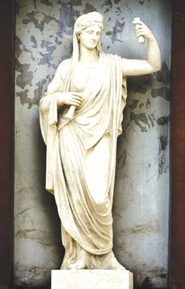
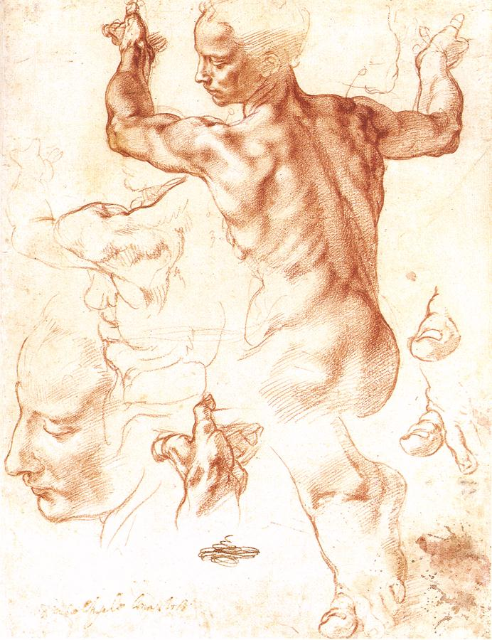
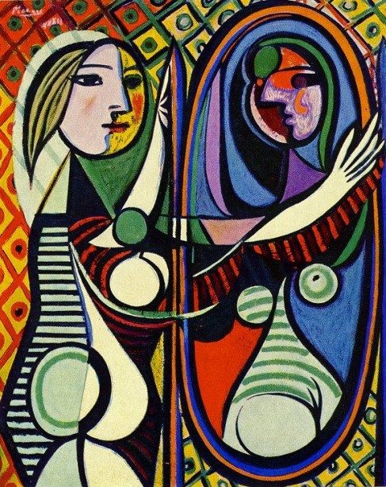
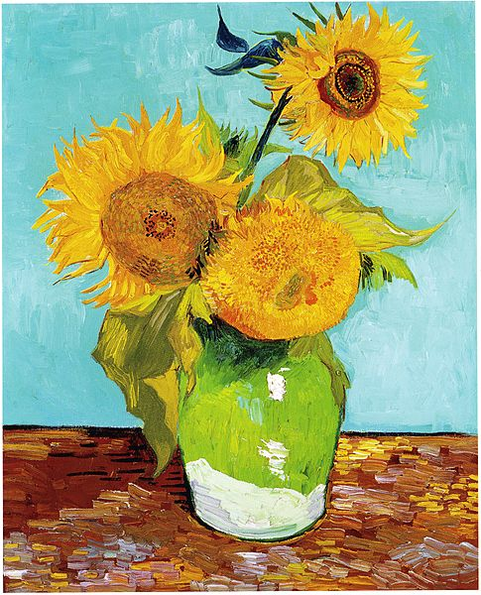
Visual Arts Department
Langstaff Secondary School
“Imagination is the beginning of Creation”
George Bernard Shaw

Slide 2
Why should I take art?
Art is fun and helps to develop critical thinking skills.
Our program focuses on developing skills and techniques with a variety of disciplines.
A growing body of research indicates that art programs actually improve students’ performance in academic subjects. (Alison Armstrong)
Did you know that the field of design is the fifth largest industry in Canada and growing everyday.
Do you know how many careers fall under the “visual design” umbrella? Lots!!!
All post secondary art programs require portfolios for admission and many of our graduates have been accepted into competitive programs such as animation at Sheridan College, as well as Architecture at the University of Waterloo.

Slide 3
Why is our program so unique?
The art program at Langstaff explores a variety of traditional and digital media, as well as specialty courses such as photography and sculpture.
Our program takes a “cross-curricular” approach with connections make to history, math, science and literature.
Our courses will allow you to “think critically” as you create beautiful artworks and develop a portfolio in the senior grades for post-secondary.
We offer exciting fieldtrips to the A.G.O, the R.O.M, the Design Exchange, the McMichael Gallery, the Distillery District and every two years New York City and/or Europe!!!
We invite amazing guest speakers and professional artists in photography, sculpture and animation to work with our students.

Slide 4
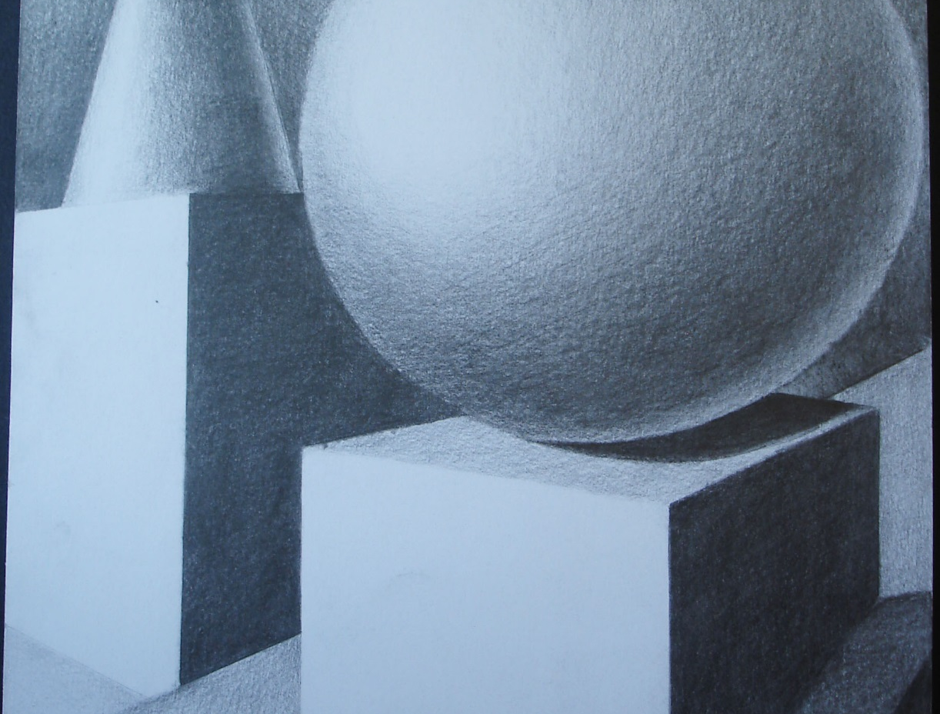
Grade 9 Drawing Skills
In Grade 9 Art, students explore the disciplines of drawing, painting, sculpting, mixed media and print making. They create a variety of two and three-dimensional artworks.
All required skills are taught from the basics to ensure that all students are successful.
Students also learn about artists past and present as they explore styles and techniques to enhance their own creative projects.

Slide 5
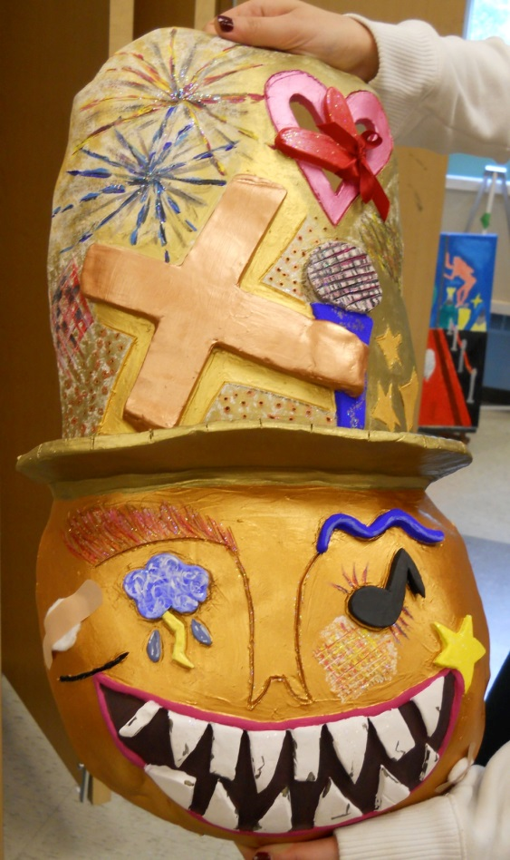

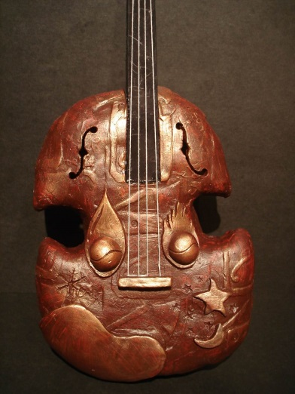
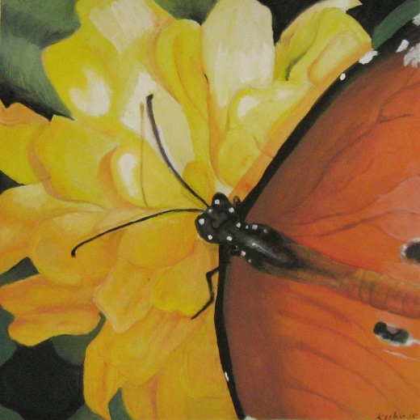
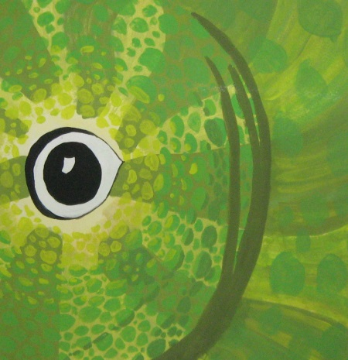
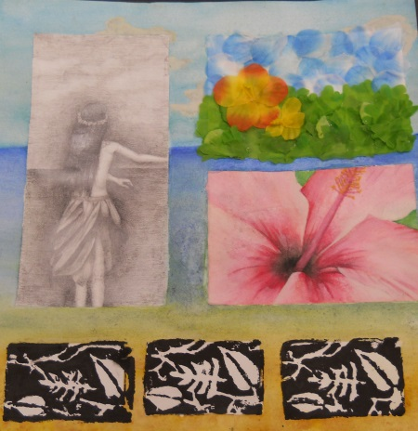
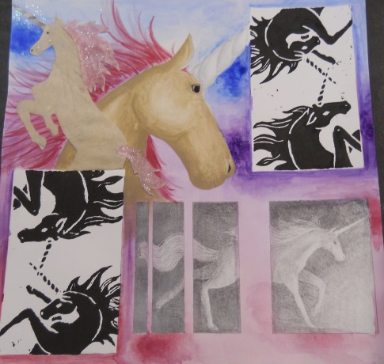
Grade 9 Art Projects (AVI1O1)
The Grade 9’s learn about proportion, elements & principles, shading skills, still life & composition, painting, clay mask sculpture, printmaking and mixed media.

Slide 6
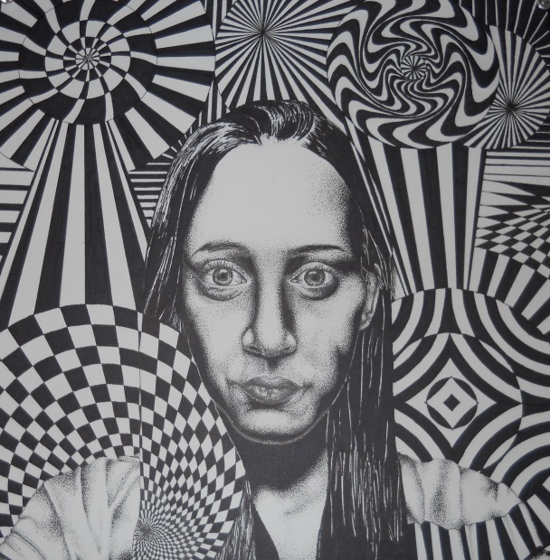
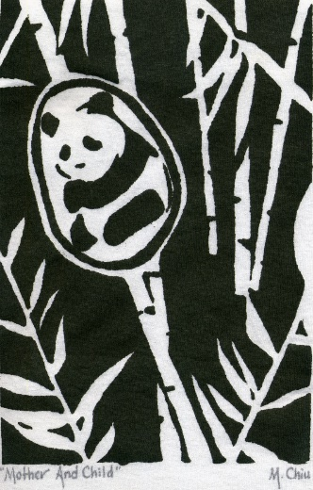
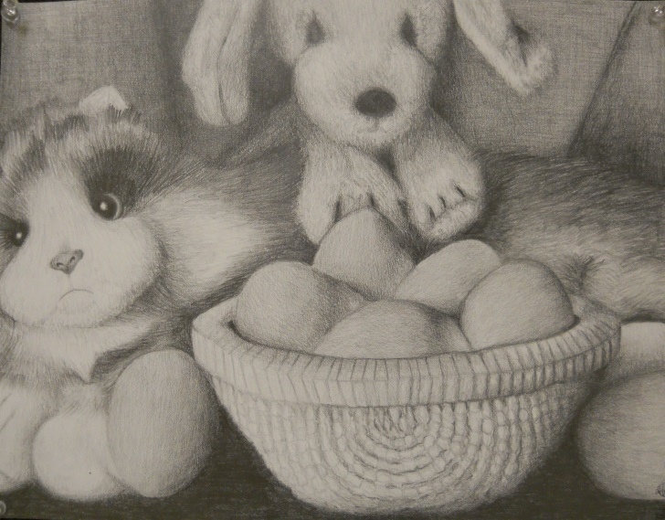
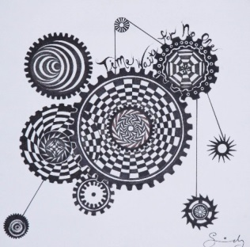
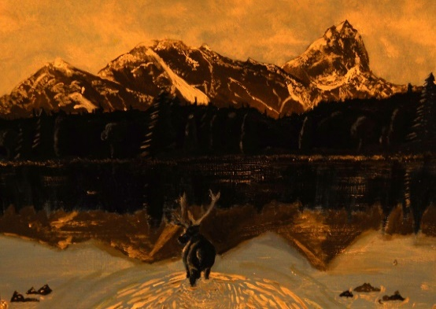
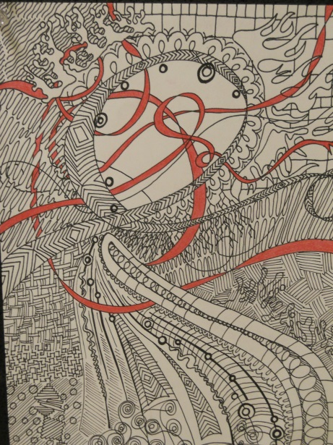
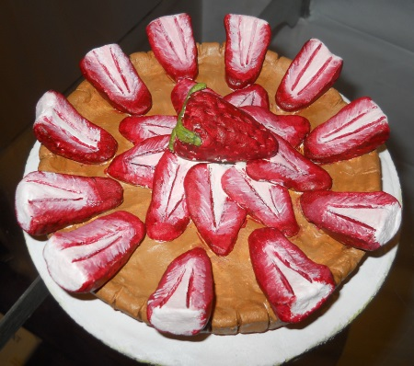
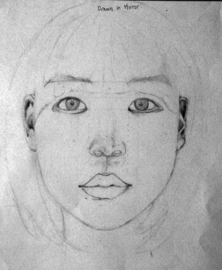
Grade 10 Art Projects (AVI2O1)
The Grade 10 art students build on skills learned in Grade 9 Art and explore, optical illusions, acrylic painting, and clay food sculpture. They also learn to map out the proportions of the face to create the first self-portrait.

Slide 7
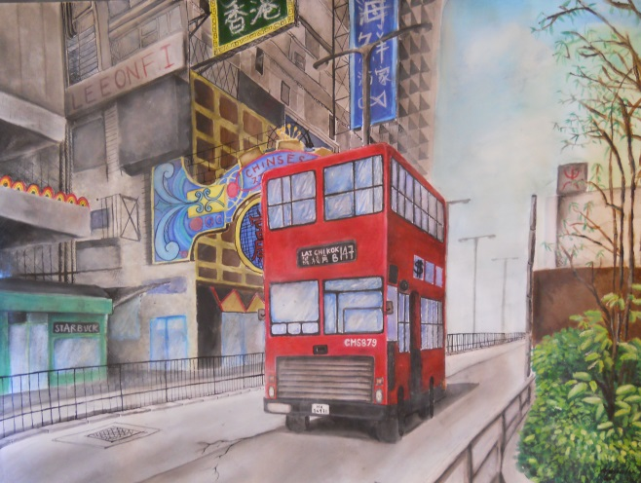
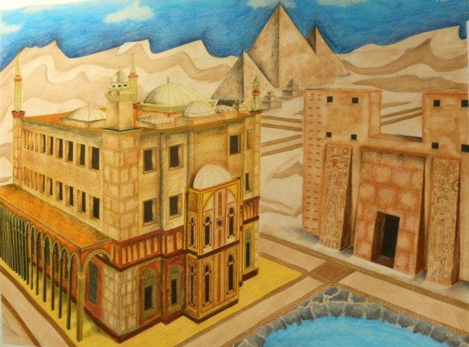
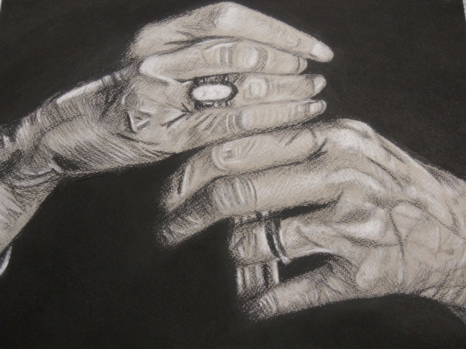
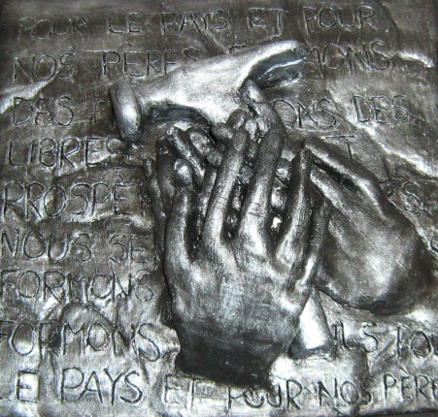
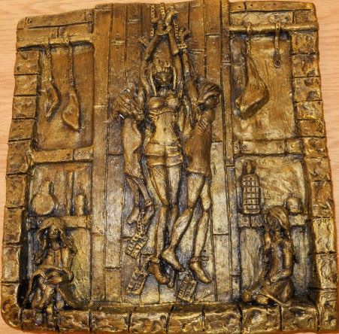
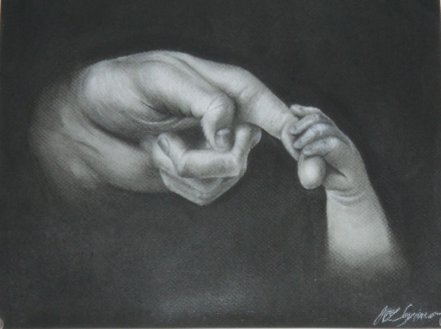
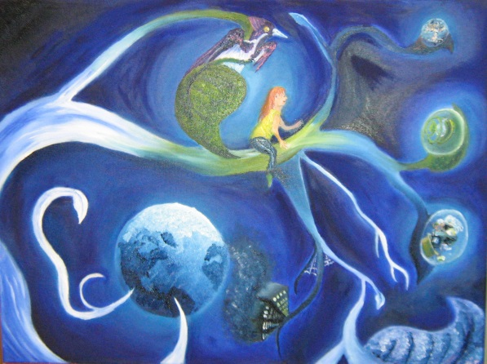
Grade 11 Art Projects
(AVI3M1)
The Grade 11’s work with charcoal and mixed media, explore two-point perspective, oil painting, and relief sculpture. At the senior level, students will begin to create larger scale artworks and work towards preparing a senior level portfolio.

Slide 8
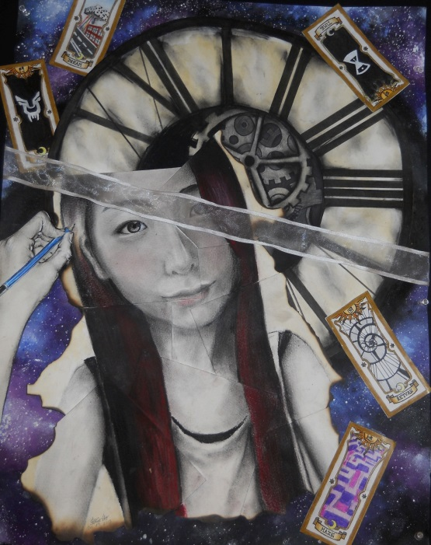
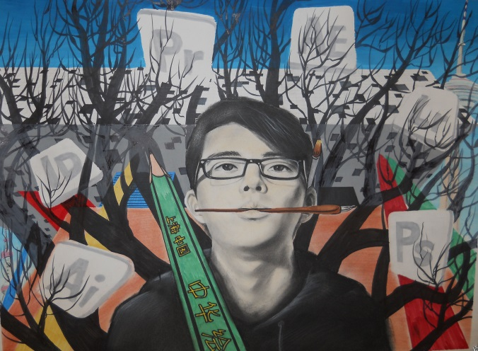
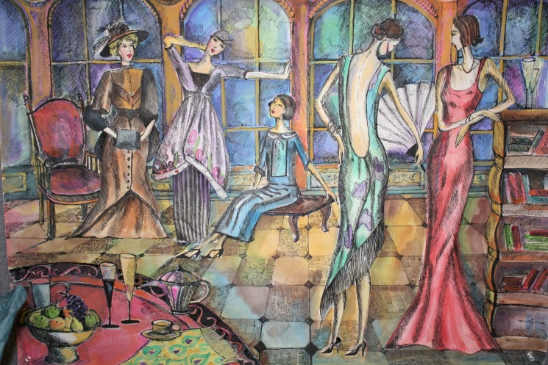
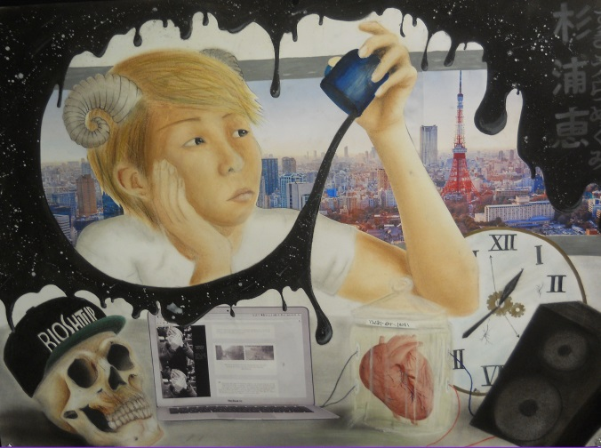
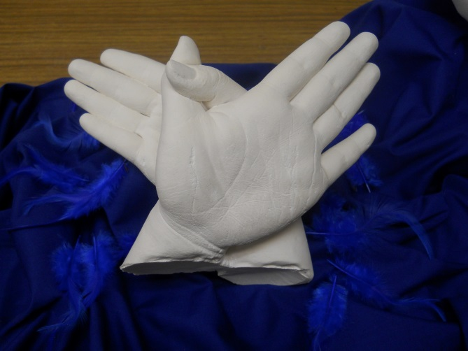
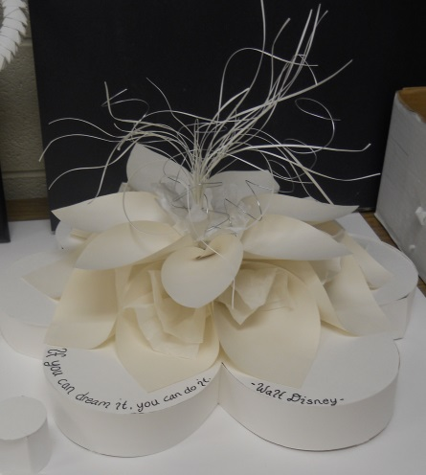
Grade 12 Art Projects
(AVI4M1)
The Grade 12’s work in mixed media, paper sculpture, public space art, and develop a portfolio for a variety of Post-Secondary programs. The students focus on refining their artistic style and write their very own artist statement.

Slide 9
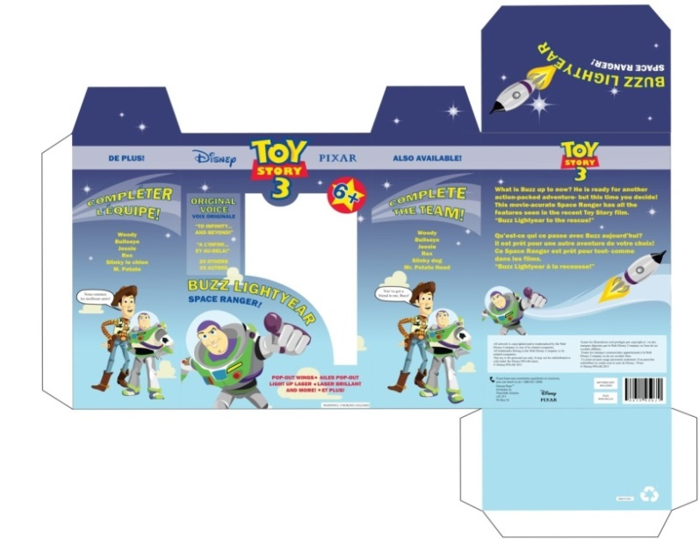
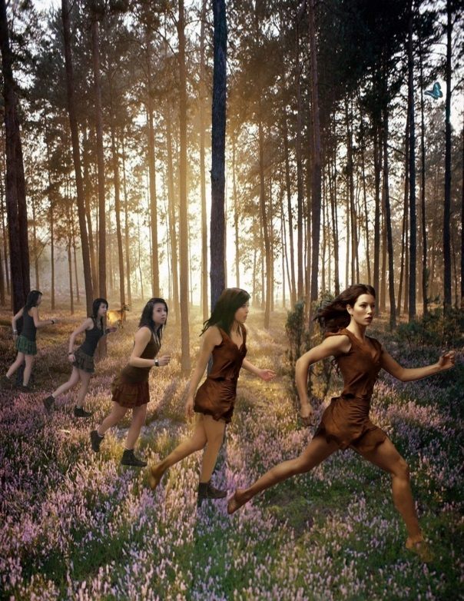
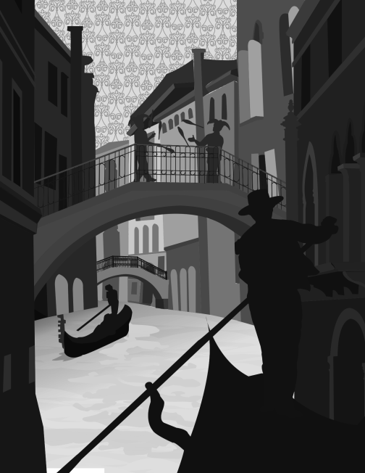
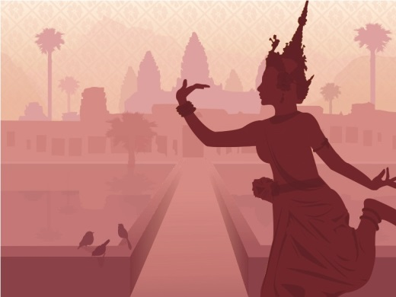
Design Courses in Grades 10, 11, & 12 (AWS2O1, AWS3O1, AWS4M1)
These Graphic Design courses work great as a whole - students learn about design principles, typography, movie poster design, package design, character design, and so much more in our MAC Lab using Adobe software.

Slide 10
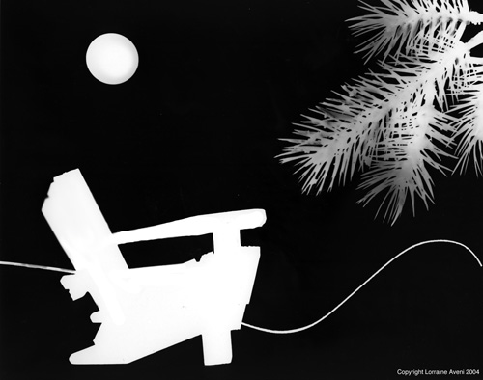
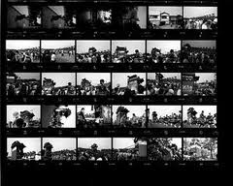
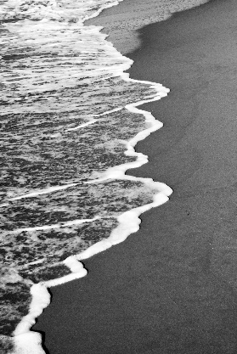
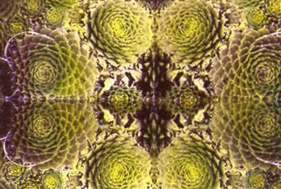
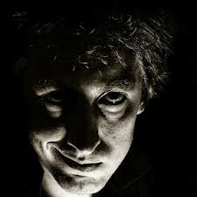
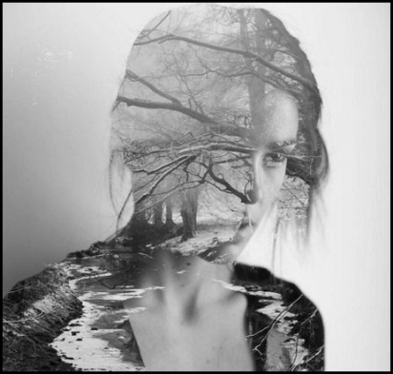
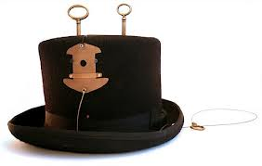
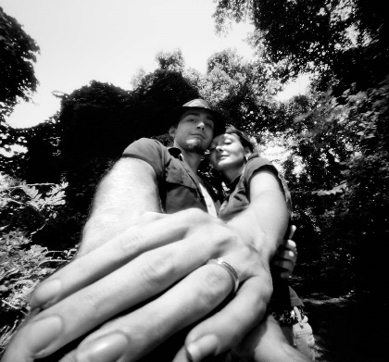
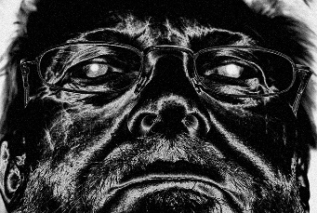
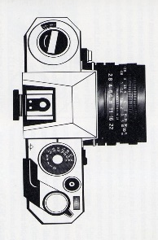
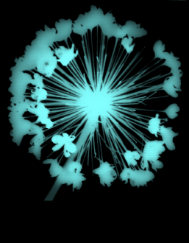
Grade 11 Photography
(AWQ3O1)
In the Introductory Grade 11 Photography students learn to use professional 35mm film cameras and traditional darkroom techniques to create black & white negatives and enlargements. They also work with Digital SLR cameras and work with a variety of image manipulation techniques using Adobe Photoshop. In Photography, students explore lighting techniques, making photograms and manipulating prints both in the traditional and digital darkroom for amazing effects!

